Slide 1

EVDrive “e-Harley” Concept Prototype Touring/Parade Bike
for Hisun
User Manual
See notes at bottom of slides for additional instructions
Link to this Manual -> http://bit.ly/EVDrive-Hisun-e-Harley-Manual
Notes:
PRINT OUT WITH THESE SPEAKER NOTES - USE “NOTES PAGES” OPTION IN POWERPOINT

Slide 2
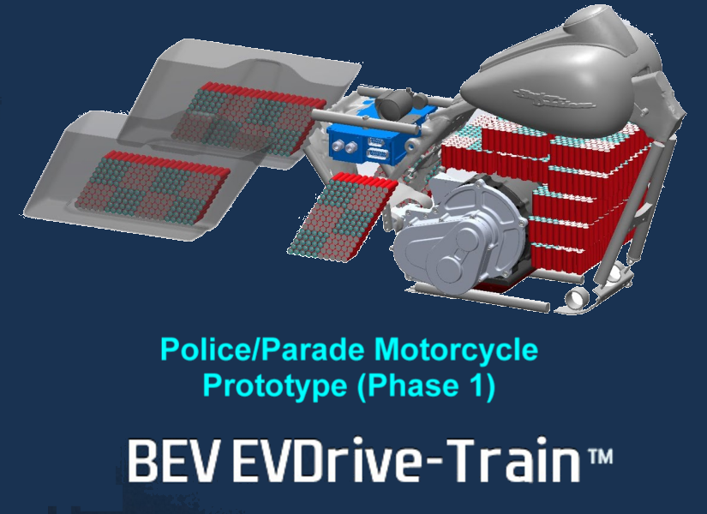
Table of Contents
General Walkaround of Key Features
Normal Operations
HMI - Splash screen
HMI - Main screen
HMI - Menu screen
HMI - Battery Status screen
HMI - Adjust Auto Regen level and Throttle operated Regen
HMI - Vehicle Data
HMI - Error codes - history
Charging Procedures
Storage Procedures
Notes:
PLEASE PULL UP THIS SPEAKER NOTES BAR TO VIEW ALL NOTES IN THE FOLLOWING PAGES

Slide 3
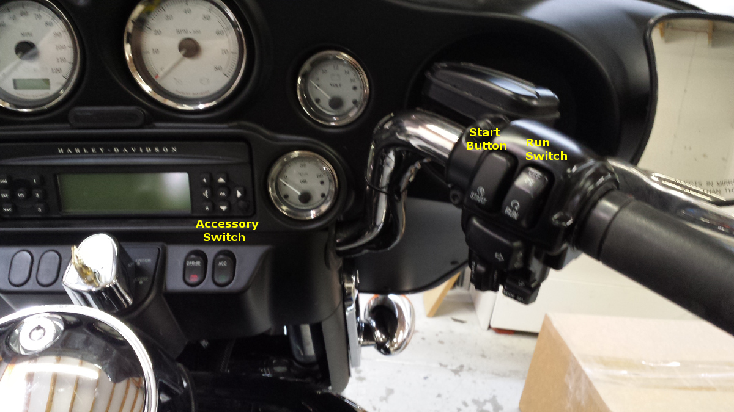
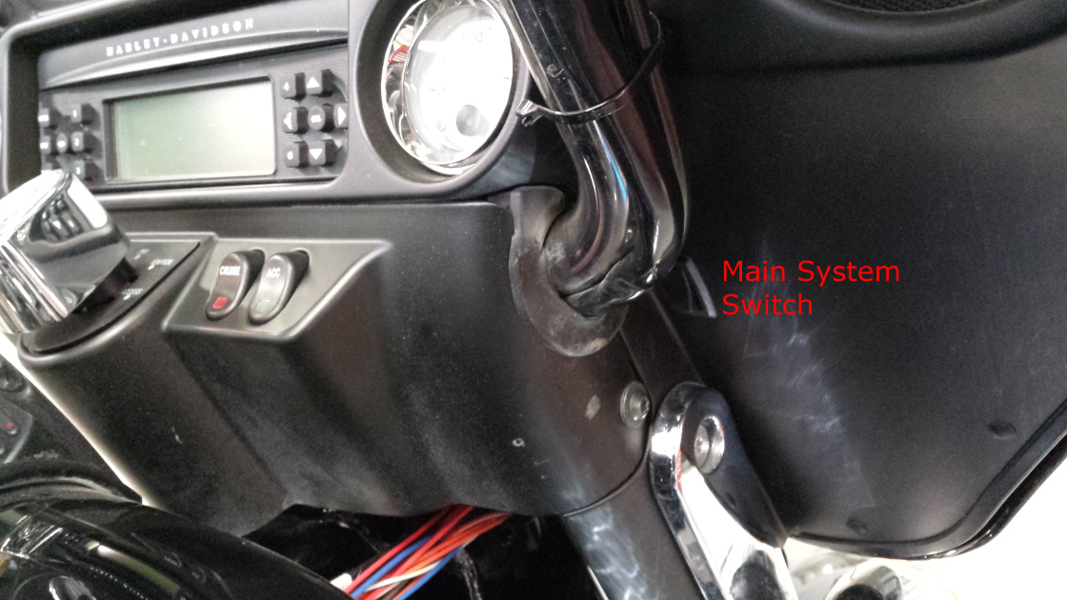
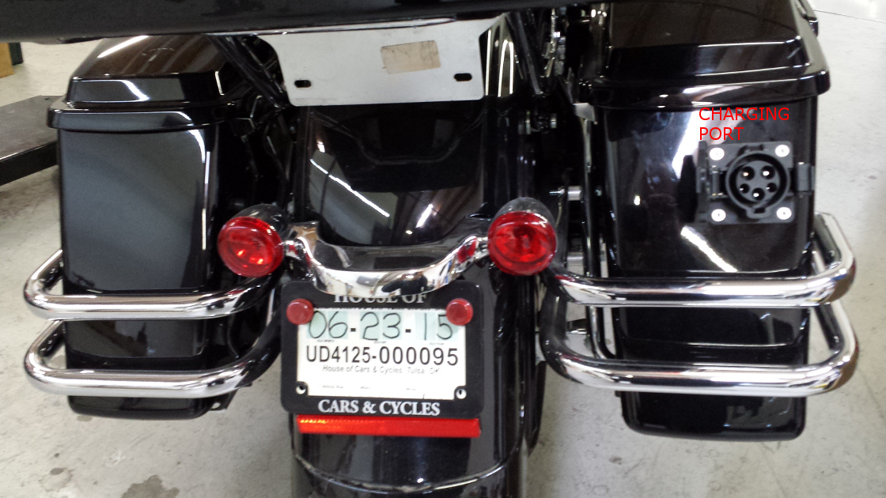
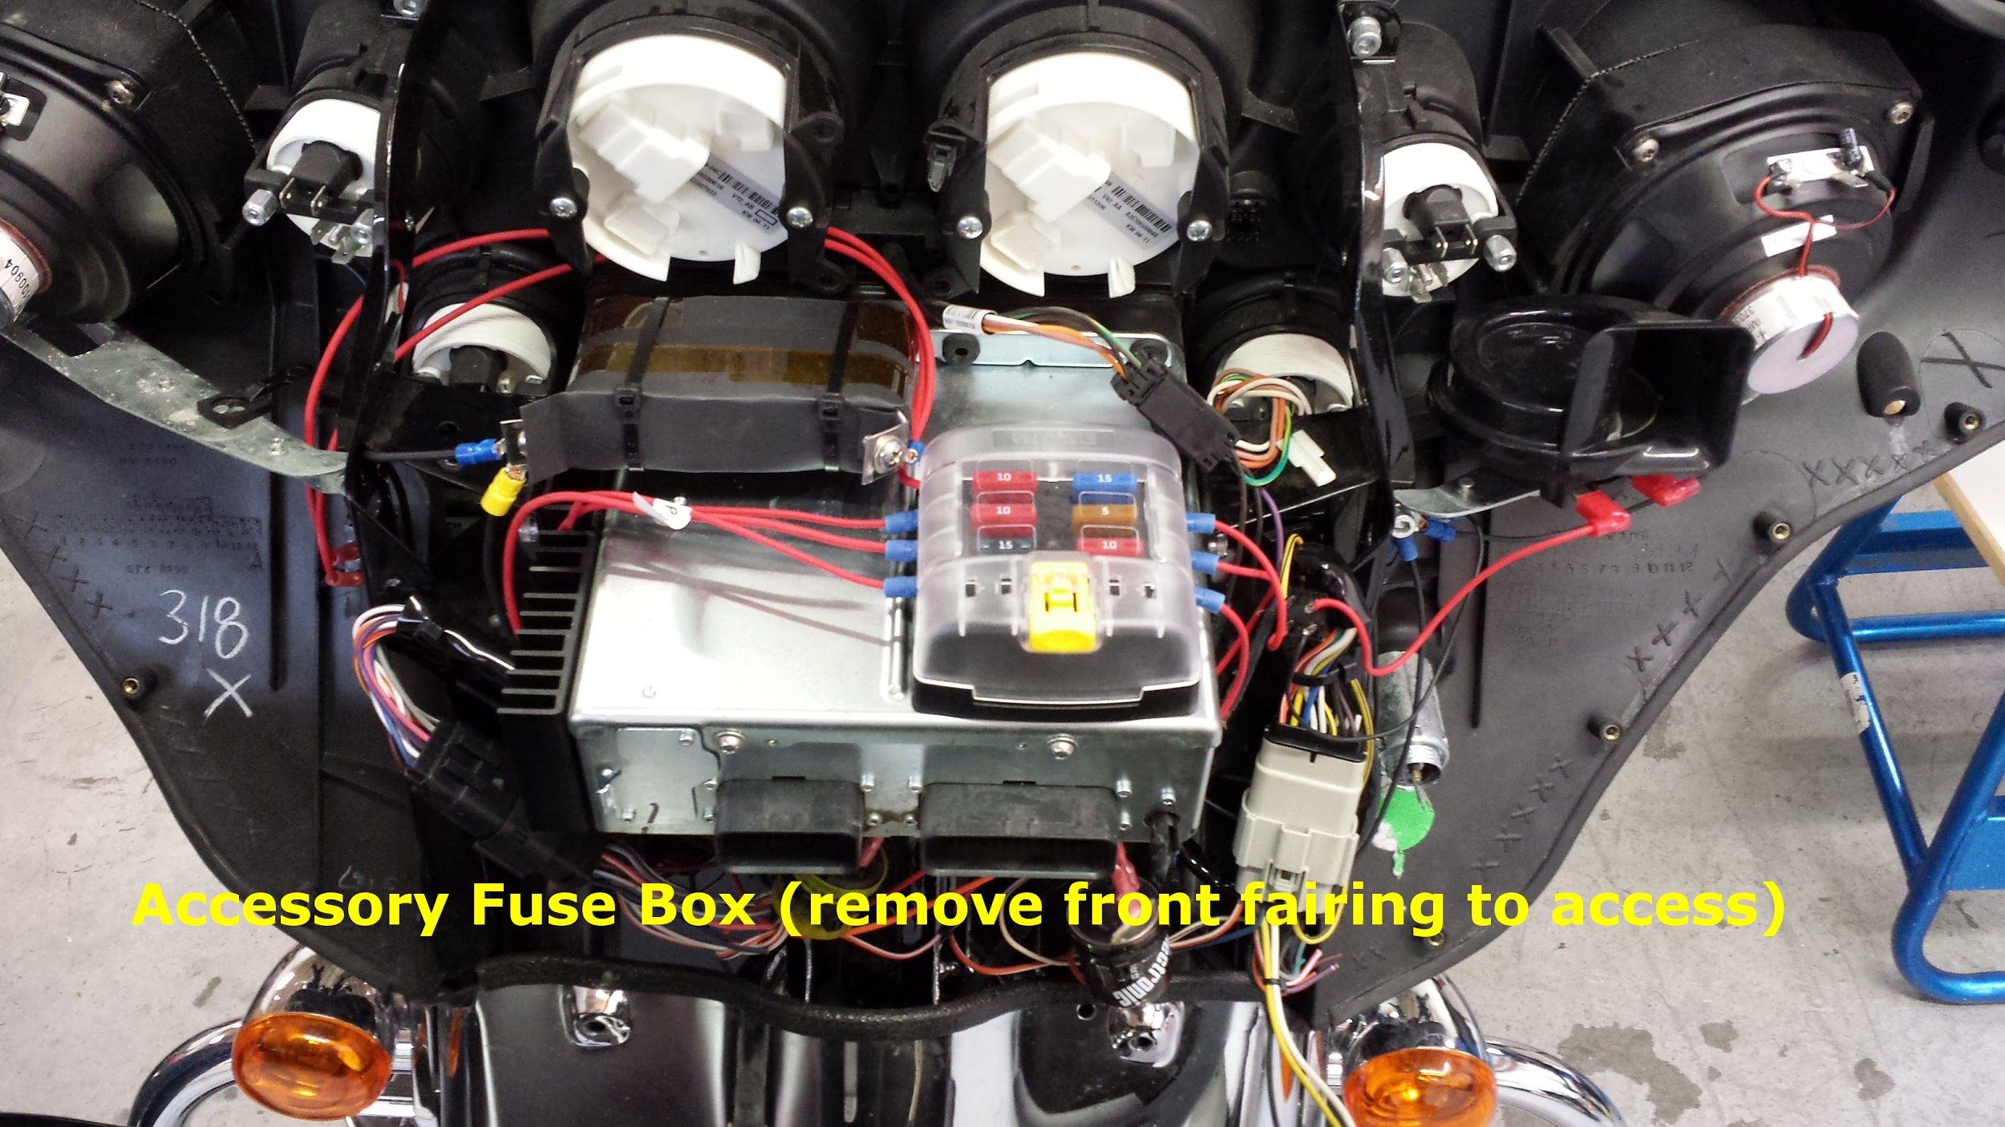
Get to Know the Prototype EVDrive-Train Powered Bike
Notes:
PLEASE PULL UP THIS SPEAKER NOTES BAR TO VIEW ALL NOTES HERE
The Harley user manual should be referenced for all information regarding the chassis sub-systems (brakes, suspension, steering, etc), accessories fuses, maintenance and storage.

Slide 4
Normal Operation
To turn on display and accessories only, press the ACCESSORY SWITCH as seen below. The traction system cannot be enabled from this mode. (make sure Main system switch is on) NOTE: The bike can be put directly in RUN mode without switching into ACCESSORY mode.
To start the bike, press the RUN SWITCH as seen below. This will put the bike in standby and turn on the headlights, but not enable the traction system
To enter drive mode, press the START BUTTON as seen below. This enables the traction system, and the bike is ready to drive. Once the start button has been pressed, use caution as the throttle is now “live”. The bike must be in RUN mode to start the traction system.
Apply power normally using the throttle. Twist towards you (CCW) to accelerate, and twist away from you (CW) to apply regenerative braking. While coasting, leaving the throttle in the neutral position applies a preset level of regen braking. Use the foot brake pedal and front hand lever as normal to apply friction brakes. This bike does not have a clutch.
The Harley user manual should be referenced for all information regarding the chassis sub-systems (brakes, suspension, steering, etc), accessories fuses, maintenance and storage.
Notes:
PLEASE PULL UP THIS SPEAKER NOTES BAR TO VIEW ALL NOTES HERE
- Key does not function on this prototype but hidden Main System Switch located right side under fairing can act as one?
- Left clutch handle is disabled as well in this prototype

Slide 5
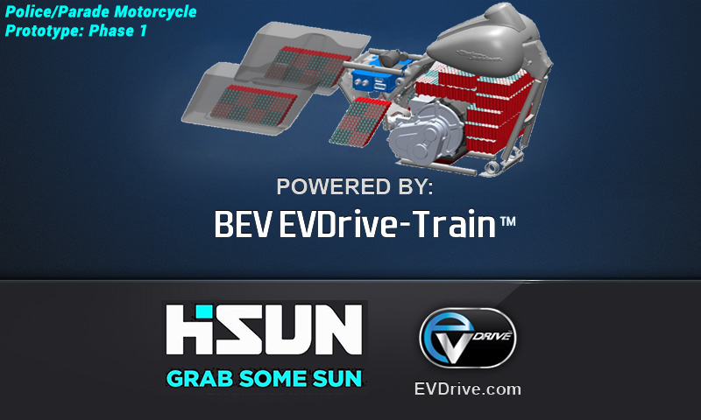
Splash Screen when bike is powered up
Additional user notes located in speaker notes below
Notes:
PLEASE PULL UP THIS SPEAKER NOTES BAR TO VIEW ALL NOTES HERE
- SPLASH SCREEN will display at power up - From system turn-on this screen will appear for 1-2 seconds during system initialization and checks. Following this, the system takes approximately 10-15 seconds to fully initialize.
- This screen, and the associated boot up time, only appears the first time the bike is initialized from a hard power down. Under normal circumstances, the display is kept in sleep mode so that the display becomes active immediately upon turning the bike on.

Slide 6
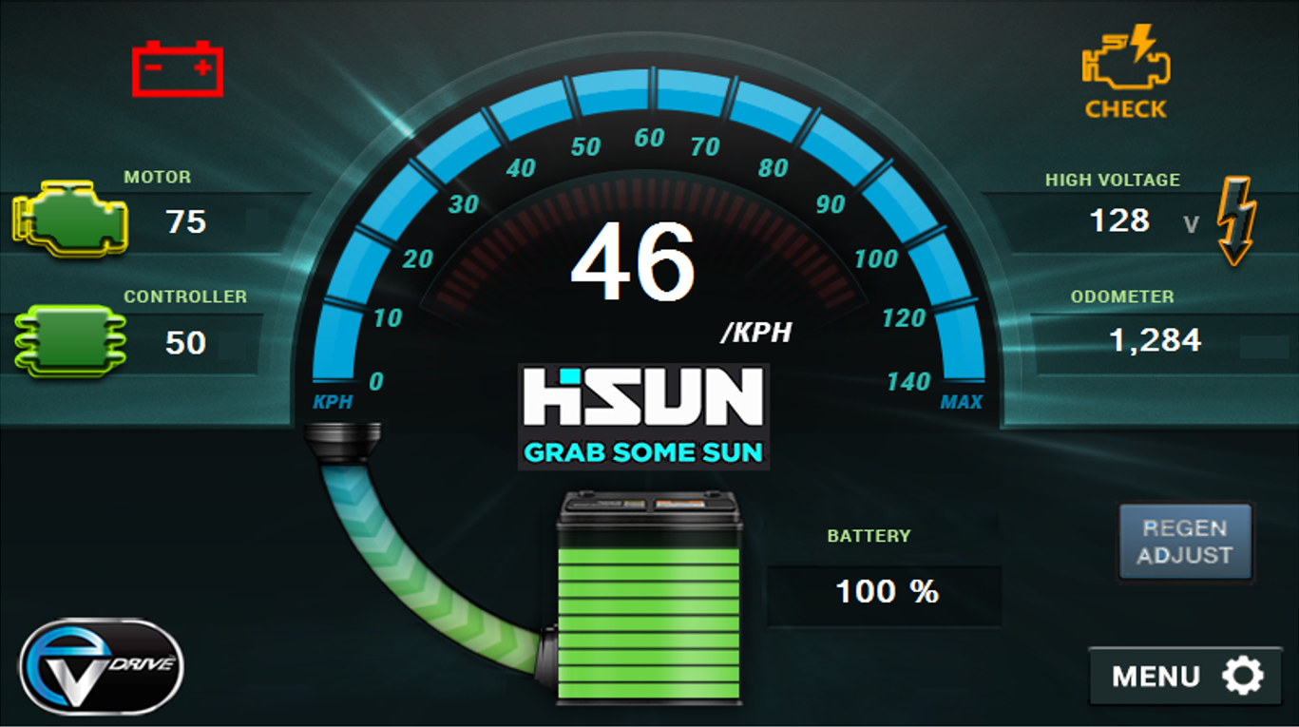
MAIN - HMI Screen #1
Additional user notes located in speaker notes below
Notes:
PLEASE PULL UP THIS SPEAKER NOTES BAR TO VIEW ALL NOTES HERE
- Green vertical bar is Battery or ESS indicator - changes to RED and flashes when pack is dangerously low (tech will set peer-to-peer safe level in screen #8). Also Touch Green Vertical Battery (ESS) Icon to jump to screen #3 shown on slide 8
- Touch “Menu” to go to screen #2 shown on slide 7
- Top left “Battery” icon shows health of back-up 12v battery
- Top right “Check Engine” telltale light flashes if there is any system fault
- ADJUST REGEN feature not available on this prototype (contact EVDrive for more information)
- Motor and Controller telltale lights change color based 3 severity levels
-“Check Engine” telltale potential messages are: Inverter_precharge_fault_flag , Aux_precharge_fault_flag , Inverter_fault_flag , Dcdc_fault_flag , Onboard_charge_fault_flag , Cab300_fault_flag , Vehicle_bmsComm_fault_flag , Inverter_comm_fault_flag , Dcdc_comm_fault_flag , Onboard_comm_charge_fault_flag , Cab300_comm_fault_flag
-”Battery” telltale potential messages are: Fault_low_cell_volt_flag , Fault_high_cell_volt_flag , Fault_low_cell_temp_flag , Fault_high_cell_temp_flag

Slide 7
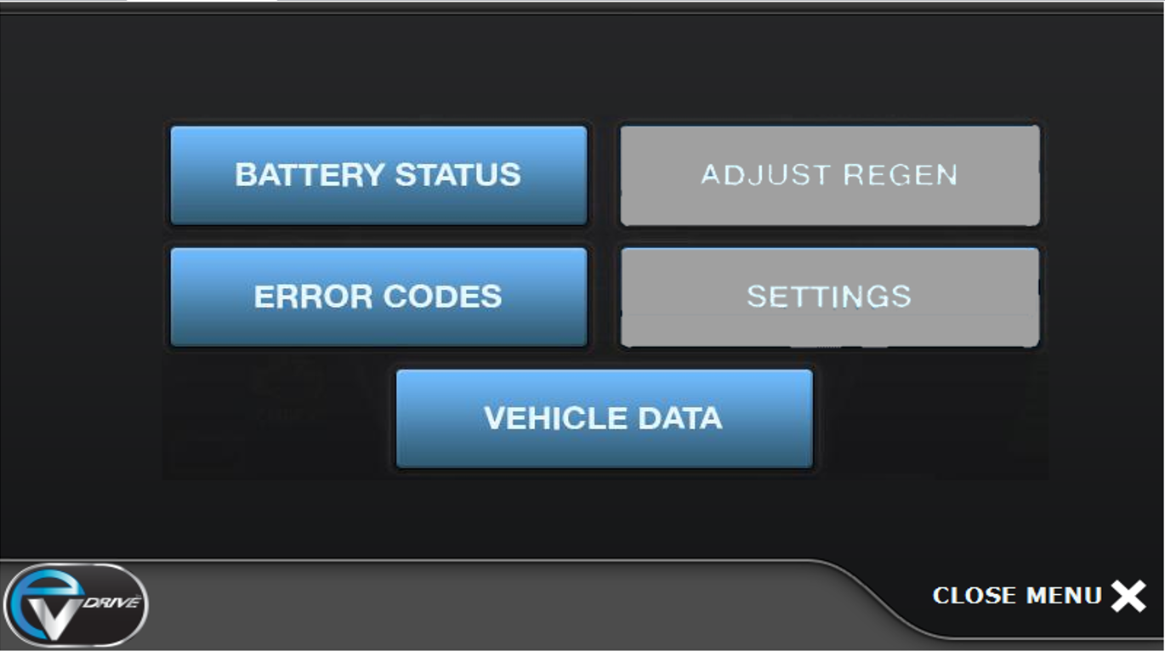
MENU - HMI Screen #2 Launched by hitting “Menu” in Main screen
Additional user notes located in speaker notes below
Notes:
PLEASE PULL UP THIS SPEAKER NOTES BAR TO VIEW ALL NOTES HERE
- MENU button on MAIN SCREEN takes you to this screen
- Press BATTERY STATUS to bring up detailed battery information as seen on slide 8.
- Press VEHICLE DATA to bring up a detailed system information as seen on slide 9.
- Press ERROR CODES to see details of any errors reported by the system, for diagnostic purposes as seen on slide 10.
- ADJUST REGEN feature not available on this prototype
- SETTINGS feature not available on this prototype
- This screen times out back to the MAIN SCREEN after a period of inactivity specified in SETTINGS.
- To immediately return to MAIN, press the CLOSE MENU button.

Slide 8
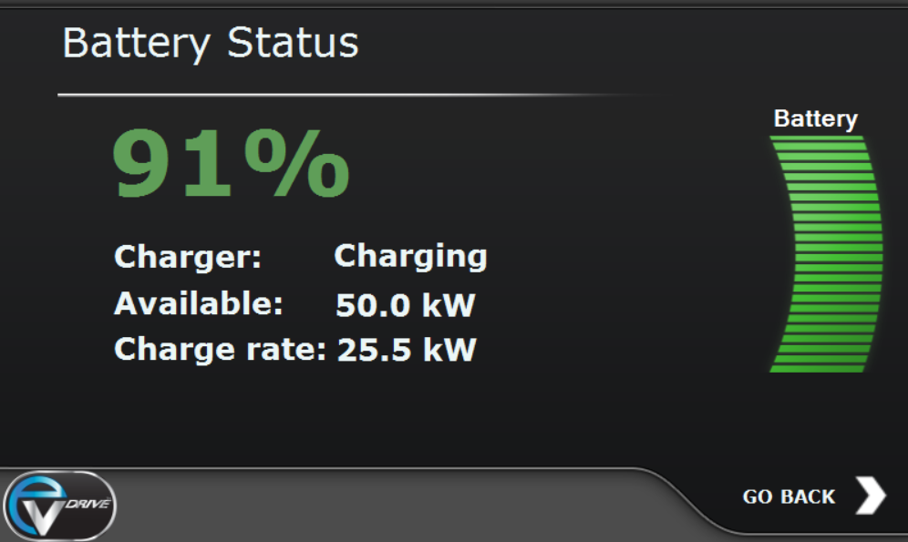

BATTERY STATUS - HMI Screen #3 - launched from Menu Screen
Additional user notes located in speaker notes below
Notes:
PLEASE PULL UP THIS SPEAKER NOTES BAR TO VIEW ALL NOTES HERE
- BATTERY STATUS button on MENU brings up this screen.
- This screen also automatically appears when charging is initiated.
- When not charging, this screen will time out to MAIN screen after the time specified in SETTINGS. To return to the MENU screen, press the GO BACK button.

Slide 9
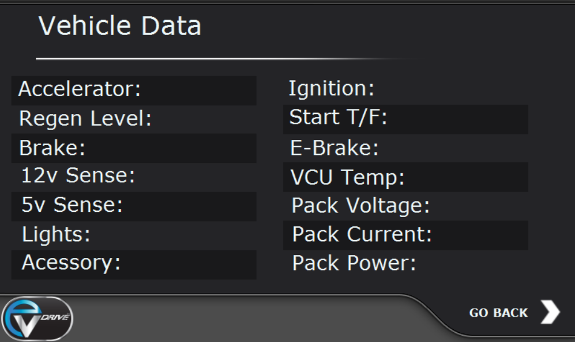
VEHICLE DATA - HMI Screen #4 - Launched from Menu Screen - Additional user notes located in speaker notes below
Notes:
PLEASE PULL UP THIS SPEAKER NOTES BAR TO VIEW ALL NOTES HERE
- VEHICLE DATA button on MENU screen brings you to this screen
- This screen displays data only
- This screen will time out to MAIN screen after a period of inactivity as specified in SETTINGS. To return to the MENU screen, press the GO BACK button.

Slide 10
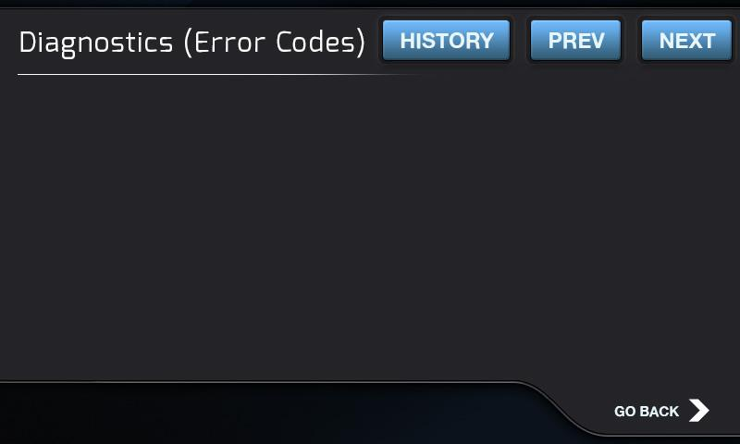
ERROR CODES - HMI Screen #5 - Launched from Menu Screen
Additional user notes located in speaker notes below
Notes:
PLEASE PULL UP THIS SPEAKER NOTES BAR TO VIEW ALL NOTES HERE
- ERROR CODES button on MENU screen brings you to this screen
- This screen displays any system errors that have occurred since the bike was power cycled.
- Cycling power will clear any previous errors displayed on this screen.
- A history of errors is displayed by pressing the HISTORY button. History is retained after power cycles, and the oldest data is overwritten when the buffer is filled.
- This screen will time out to MAIN screen after a period of inactivity as specified in SETTINGS.
- To return immediately to the MENU screen, press the GO BACK button.

Slide 11
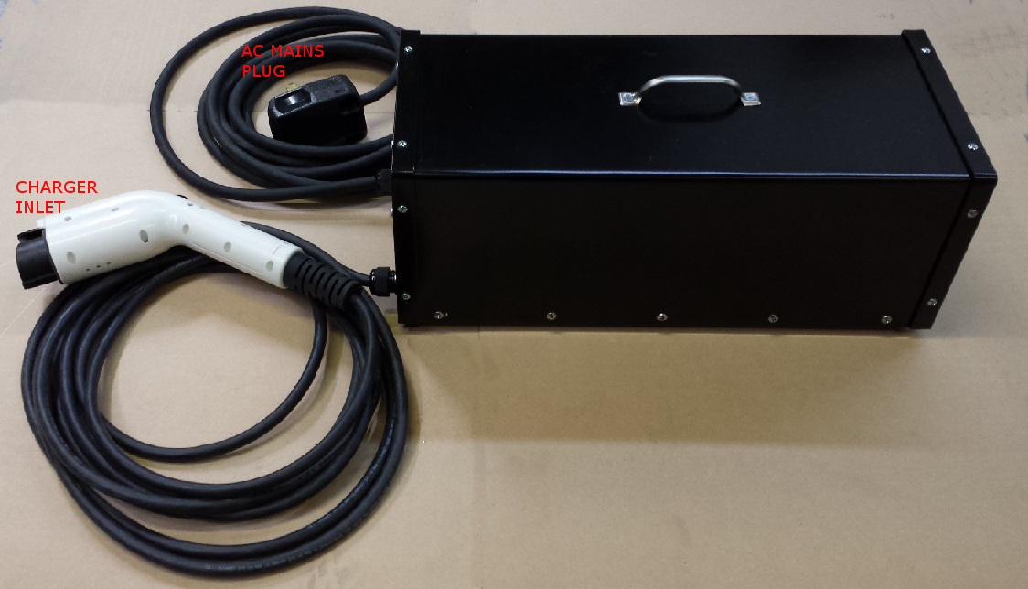
Charging Procedures
Plug the EVDrive charger inlet plug into standard 240V AC mains power.
Open the charging port, which is located at the back of the right side saddlebag (when looking at the rear of the bike). Open by pressing the latch on the right side of the port.
Insert the charging plug into the charging port. Ensure the latch engages completely by firmly seating the plug in the socket. Charging will begin briefly as shown on the BATTERY STATUS page, and the cooling fans on the charger will start.
When the battery is full, the charging will automatically terminate. Leaving the charger plugged in allows for pack balancing, which should be done periodically. Charging can also be terminated at any time by removing the charging plug.
The EVDrive charger must be used to charge this bike. Public J1772 chargers cannot be used.
EVDrive charger
Notes:
Intentionally left blank

Slide 12
Storage Procedures
For long term storage, turn off the MAIN System Power Switch located on the lower right corner of the fairing. This will prevent the battery from losing charge over time, and will prevent the bike from being started.
Notes:
Intentionally left blank

Slide 13
END MANUAL
Intentionally left blank
Notes:
END MANUAL - Intentionally left blank

